Slide 1
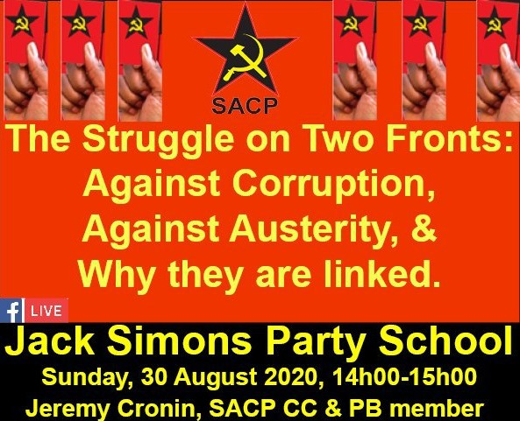

Slide 2
The Struggle Against Corruption - a new and decisive phase
The brazen looting of PPE budget resources has (quite justifiably) – provoked public outrage, including among a majority of ANC supporters, with COSATU calling for a General Strike 7th October against corruption, holding Ramaphosa responsible and calling for him “to wield a big axe”.
Ramaphosa has intervened with his letter to ANC members – “We might not be alone in the dock…but we are accused No.1”, proposing internal ANC measures – life-style audits, etc
Zuma responds: “your letter…a public relations exercise by which you accuse the entire ANC in order to save your own skin”… “a major betrayal of those who voted for you with no knowledge that their vote was going to be enhanced by the WMC donors”.
So what is the role of the SACP (and progressive left forces) in this context?

Slide 3
2018 removal of Zuma & narrow 2018 ANC NASREC Conference a new unstable balance of forces.
ANC itself largely stale-mated (NEC, NWC, Top 6) – which is why Zuma’s letter is attempting a populist outflanking of Ramaphosa from within the ANC “you’ve accused all ANC members”
In the state, however, there is steady progress:
  Clean up of SARS, PIC, NPA, Hawks, Eskom, Transnet, etc
  Eskom has recovered R1bn from McKinsey, R150m from Deloitte, cancelled R3,7bn coal contract with Gupta’s Tegeta, SIU proceeding to recover R3,8bn from Guptas, etc;
  Transnet – S China Rail repaid R618m, Pension Funds recovered R1,2bn from Gupta entities,
  Regs. for Zondo Commission changed, NPA can use Commission evidence and personnel;
  9 VBS suspects arrested, court appearance 8 October 2020, 5 of whom sequestrated;
  Asset Forfeiture Unit – 2019 R2bn recovered, early August 2020 AFU seized a bank account with R700,000 siphoned off UIF money,
  Estina Dairy and Asbestos Free State deals – net closing
  Zuma suffers series of setbacks re. Arms Deal Corruption.
  THE NET IS CLOSING – HENCE HIGH-STAKES ZUMA & co. response

Slide 4
But how did we get here?
In 1995 SACP advanced the slogan “Socialism is the Future – Build it Now!” – it marked (was intended to mark) a clear break with “stage-ism”
That is, a break with idea that the NDR was the “bourgeois” first stage, to be followed by a distinct “second stage” = socialism
Instead we were advancing the perspective of a socialist oriented struggle in the midst of the NDR – not as a free-riding hitch-hiker, not as “entryists”…But as the condition for an effective NDR itself.
In other words – our strategic positioning was to advance working class and popular hegemony (not “dictatorship”, not unilateralism) over the NDR
A prospect made possible – but still very challenging by the 1994-96 democratic and constitutional rupture with white minority rule.

Slide 5
A bourgeois hegemonic struggle for the NDR
The “Build it Now” SACP programmatic orientation knowingly challenged a different class hegemonic project within and beyond the ANC.
The “1996 class project” – essentially a stage-ist vulgarisation of the NDR “Socialism might be the future…Build it THEN” = major revision of ANC strategic approach – certainly since Morogoro, if not F Charter 1955.
The NDR = a stage of “normalising”, “modernising” & “de-racialising” (and latterly as “en-gendering”) SA’n capitalism.
CDE: “Policy-Making in a New Democracy”, (1999) (sponsored by SA Breweries): “What the country needs is a new centre of gravity for the ANC as the leading party in SA’s government (…)The ANC itself needs to become an instrument for marketing and selling the new approach (…)We are not suggesting that modern revolutionaries in the global village should all have MBAs, but this is a useful analogy…”

Slide 6
1996 class project
This revisionist hegemonic project (with the support of monopoly and imperialist capital) attempted to build on several pillars:
Locking in neo-liberal macro-economic policies – with “trickle-down” redistribution
Transforming the state apparatus – “right-sizing”, privatising, public utilities shaped as S-O Enterprises – the “tenderised” state
Transforming ANC from a movement into an electoral formation, and with a narrow presidential “Bonapartist”/managerialist centre
Cultivating a new class force within the ANC – “a patriotic black bourgeoisie” to counter-balance weight of organised working class
New ethos: Phumzile Mlambo-Ngcuka “blacks should not be ashamed to be filthy rich” (2002); Smuts Ngonyama “I didn’t struggle to be poor”

Slide 7
Aggressive offensive against SACP
“Build it now” – (deliberately) misinterpreted
Mbeki and his circle portrayed SACP’s strategic positioning as “ultra-leftist”, even as “insurrectionist”, as “treasonable against democratically elected government”.
2002 Moleketi & Jele “Two strategies of the NLM”
Dumisani Makhaya - alleged that the SACP leadership regarded April 1994 as a “February 1917”, and that the Party was now bent on making its own “October” in order to crush the “Kerensky’s” in the ANC
In 2001 and 2002, ANC elements in government sought to portray the mass worker stay-aways against privatization policies as “an uprising” against the state.

Slide 8
The unstable hegemony of the 1996 class project
Could not win key positions democratically within ANC/Alliance –
  Late-1993 Transitional Executive Council – IMF loan $850 million and secret “letter of intent” (promising wage restraint, inflation targeting, trade & industrial liberalisation, etc)
  GEAR – “non-negotiable”, “written in stone”
Action by stealth – “legalising the political, politicising the legal” see Mbeki’s mishandling of Zuma corruption charges – played the legal card within the ANC NEC (“can’t discuss it – a matter for the courts”, while politicising the NPA/Scorpions – Leonard McCarthy, Bulelani Ngcuka
Trickle-down couldn’t work – growth, but jobless growth, growing mass dissatisfaction
Growing factionalism around BEE promotions – not every black person could become “filthy rich” – emergence of provincial fiefdoms, based on provincial parasitism

Slide 9
Vectors for corruption pandemic
Most anti-corruption discussion focuses on:
  Strengthening the Criminal Justice System and more general a “Capable State”
  Moral issues - Building an “ethical leadership”, promoting values of public service, batho pele, etc
These emphases are correct…and SACP must support them…however, what are the underlying SYSTEMIC features of our society that provide the vectors for this run-away plague of corruption??
3 Inter-related Issues:
  The attempted promotion of a “black patriotic capitalist class”
  The “tenderised” state
  Party political fund-raising – multi-party democracy on the terrain of capitalism
All of this in the context of a political economy with massive unemployment, poverty and inequality

Slide 10
Vector 1 - Attempted promotion of a stand-alone “black patriotic capitalist class”
For 1998 Alliance Summit – Mbeki grouping developed a strategic paper (“The State, Property Relations & Social Transformation”) arguing for the promotion of a “black capitalist class” as an important strategic objective of the NDR:
“In a systematic way, the NDR has to ensure that ownership of private capital at all levels…is not defined in racial terms.”
“Thus the new state – in its procurement policy, its programme of restructuring state assets [AKA privatisation], utilisation of instruments of empowerment, pressure and other measures – promotes the emergence of a black capitalist class.”
Notice how in this version of the state it is a procurer, privatiser and regulator – not a productive doer – more of which below.

Slide 11
Stand-alone “patriotic blk bourgeoisie” possible?
SACP raised 2 related points:
1. With SA’s relatively developed capitalist economy and long-established South African capitalist class (overwhelmingly white and male, of course) possible for a stand-alone black capitalist class to be forged?
2. Even if possible, could such a hypothetical class play a patriotic role, driving technological modernisation and broad economic development?
Saki Macozoma (2003) on BEE: “there is no other practical & effective instrument for SA to deracialise the economy within a reasonable time”
i.e. elite redistribution = de-racialisation of capitalist economy = NDR

Slide 12
Structural reasons for impossibility of a vanguard NDR by blk capitalist “class”
SA mid-1990s
Not South Korea early 1960s – with a GDP then less than Ghana, under military dictatorship of Gen. Park, and with Cold War support of US imperialism – launched massive export-led industrialisation led by authoritarian rule and an emerging national bourgeoisie (Chaebols)
Not a backward China late 1970s without a capitalist class – Deng Xiaoping cautiously liberalised under firm control of CCP and strong state, allowed emergence of a modernising, technologically developing Chinese capitalist class (eg. Jack Ma)
Nor could we follow example of Afrikaner Volkskapitalisme – whose primitive accumulation based on hyper-exploited, influx-controlled black farm labour

Slide 13
Aspirant capitalists without capital
Primitive/Primary Accumulation
Aspirant capitalists require some form of “primitive accumulation”, to enter into the process of expanded capitalist accumulation
In SA 1990s SACP argued: new fractions of the capitalist class could only substantively emerge through two forms of primitive accumulation:
  Indebted share-holding from existing monopoly capital – BEE route (with all the dangers of fronting and compradorism), or
  Looting of public resources (parasitism, state capture).
Mbeki group conceded: “While these forces [an emergent black capitalist class] are direct beneficiaries of the NDR…they can easily be co-opted into the agendas of their white counter-parts; and they can easily also become a source of corruption within the state.” (1998)
A prophetic concession, but Mbeki paper simply concludes: “ANC leadership of these forces is therefore critical” –
BUT WHO NOW LEADS WHOM?

Slide 14
Intra-black GINI inequalities = fastest growing inequality in SA
Numbers of SA’n dollar millionaires:(R14,5m or more net assets)
2007 – White - 36,000
Black – 6,200
2015 - White - 21,200
Black – 17,300 (i.e number nearly trebled in 8yrs)
Percentage SA’ns who are $millionaires 2015 – White 55%, Black 45%
(Businesstech – 20 April 2016)

Slide 15
Wealth inequality among Africans now almost = to overall SA’n wealth inequality
Asset GINI coefficient (household head)
Black African
0,54
0,50
0,56
White
0,38
0,34
2015 0,34 (source: StatsSA, Inequality Trends, 2019)
Close to general GINI =
0,59

Slide 16
Important Qualifications
SACP not saying black capitalists individually/collectively necessarily bad people (anymore than white capitalists) – BUT there ARE systemic limitations:
Saki Macozoma: “How do you expect me to behave any differently from other capitalists? If I did, I would soon be out of business.”
SACP supports:
  Freedom Charter call to remove all racial/gendered restrictions on rights to trade, etc.
  Wide range of targeted affirmative action measures (that take into account race, gender & class) – Employment Equity, Land Reform, NSFAS, Black Industrialists Programme, state support for cooperatives and SMMEs, “township economy”, Recognition of Prior Learning, etc etc
Insofar as we ARE in a capitalist society, SACP supports state intervention to compel/incentivise “patriotic” behaviour by capitalists (black & white) national re-industrialisation, job creation, fixed investment, prescribed assets/impact investments, localisation, beneficiation. Actively curb capital flight, base erosion using off-shore tax havens and illegal transfer pricing

Slide 17
2nd key vector for corruption pandemic
The Tenderised State
Integral part of the neo-liberal turn in mid-1990s was the embrace of New Public Management = re-purposing of state:
State “should steer not row” – a regulator and procurer, to create “market friendly” conditions - not a doer
Public sector workers financial drain – Trevor Manuel: “It’s not the job of the state to create jobs”; “Government is not an employment agency” – nursing and teacher training colleges closed, etc.
“Right-sizing” of public sector – professionals take retirement packages, and return as private consultants, private contractors
Privatise and/or corporatize public utilities (which become SOEs) expected to return “profit” to “share-holder” government – closing of Transnet’s massive engineering and artisanal training facilities
Outsourcing of former state capacity – even outsourcing of public policy development (DoT and NatMap, or annual outsourced ritual of municipal IDPs) – capacity not developed internally
De-centralisation of financial accountability – abolition of State Tender Board (2000)

Slide 18
De-tenderising the state doesn’t mean “abolishing the tender system”
The massive neo-liberal undermining of productive state capacity has meant massive increase in procurement from private sector
But even with a more effective national democratic developmental state there will still be the need for (less) external procurement – this must be done, however, through a thoroughly transparent process
Also state must become a price-maker/ not a price-taker – hence huge problem with 2000 abolition of State Tender Board – and imperative of rebuilding and defending Central Procurement Office
This is what WE mean by a more “capable state”

Slide 19
3rd Systemic Vector for Corruption Pandemic
Political Party Funding
Global crisis for liberal democracy – particular challenge for progressive political platforms – see Corbyn in UK, Sanders in US
Since unbanning of ANC – party funding has been a problematic challenge – Madiba and “two China” approach (because of funding from Taiwan); got murkier later – Chancellor House, Arms Deal, Eskom build/Hitachi, etc
The line between party funding-raising, personal enrichment & state capture gets increasingly blurred – (See Nomvula Mokonyane and Bosasa)
Even more blurring when it is funding raising for competing Party factions – CR17 campaign reported to have been funded by R500m; Musi Maimane – funded R100m vs. Wilmot James; EFF’s attack on SARS related to funding from Adriano Mazzotti…and current heavy line supporting lockdown??? Vs. DA’s “open up economy”; or Geordin Hill-Lewis’s 2015 private member’s “Remote Gambling Bill”

Slide 20
The 3 vectors and the socio-economic triple crisis
These 3 vectors – use of ANC to promote a narrow BEE elite; the tenderisation of the state; and party political funding in a capitalist society interact with:
Unsustainable crisis of inequality, poverty, unemployment – (now getting worse with C-19)
Resulting in severe dangers of a polluted political terrain – where political office and/or association with someone in political office – can be the one chance of escaping a life-time of unemployment and grinding poverty.

Slide 21
Zuma presidency “9 wasted years”, or the next unstable hegemony?
“9 wasted years” narrative obscures the active complicity of the 1996 class project (AND established monopoly capital) in
  the 3 major vectors for corruption,
  the earlier politicising of criminal justice system,
  first wave of corruption, state capture (Arms Deal, Selebi-Agliotti) and
  triple socio-economic crisis
Which is not to deny exponential explosion of corruption in Zuma years – and particularly his 2nd term (2014-18)
2007 Polokwane outcome (a 60%/40% JZ victory) – based on an unstable “marriage of convenience” between a left axis (SACP/COSATU), and parasitic primitive accumulators (especially anchored around provincial networks) – but with 40% 1996 class project still relatively strong

Slide 22
Zuma’s 1st presidential term (2009-14)
Zuma first term (2009-2014)
Zuma seeks to hold together:
  left-axis/parasitic accumulators/ and 1996 class tendency
  left gets key ministerial posts (dti, economic development);
  1996 class project dominates planning commission, and Treasury left intact
  while Malema, ANCYL, provincial looters, given great latitude.
Main Zuma focus = “stay out of jail card” – massive assault on criminal justice system, SARS and intelligence apparatus – but fails largely to subvert judiciary.

Slide 23
Zuma’s 2nd presidential term
(2014-18)
Having corroded NPA, SARS, Hawks, Intelligence, SAPs leadership, SABC, PIC – state capture plunder takes off, major focus on key SOEs
But failure to capture – Treasury, SARB, FIC, dti, DED, DBSA, IDT, Judiciary, and (initially) Public Protector, critically SANDF, plus much of media
Unstable 2007/09 unity begins to fall apart
2008 global financial capitalist crisis – impacts on SA and ends commodity super-cycle – upon which GEAR-based GDP growth had depended – deepening of already crisis levels of poverty, inequality, unemployment.
2016ff – emergence of a broad “anti-corruption” front inside of ANC, Alliance and beyond – including SACP, COSATU, 1996 class project networks, and range of civil society and big business formations (eg. BUSA)
Critically – unlike Brazil, where left/progressive forces were off-balance in the anti-corruption fight – we did not/have not allowed anti-corruption struggle to be hegemonized by neo-liberal axis.

Slide 24
A “new dawn”??
This broad anti-corruption front was the basis on which JZ was forced to step down (partly as a result of shift in ANC parliamentary caucus), and upon which CR17 won tiniest of victories at 2018 NASREC Conference
CR attempts to unify three key forces in ANC-alliance – left axis, 1996 class project, and some Zuma-ites…while applying slow poison of re-vamped criminal justice system and Zondo, Mpati commissions – thoroughly unstable reality.
For left axis – CR17 victory = opportunity to embark on a serious 2nd radical phase of the NDR
For 1996 axis (and monopoly capital)– CR17 victory = opportunity to return to “good policies” of 1996
For Zuma-ites – control over much of ANC organisationally presents opportunity to sustain primitive accumulation (under false flag of RET) and to stay out of jail & reverse CR17 outcome through paralysing ANC top6 and NEC, and an elective NGC

Slide 25
CR’s leadership
Growing chorus: “Act more Decisively”
In public domain – growing focus and real/manufactured disappointment at CR’s “leadership style”, “consensus-building approach”, “failure to act more decisively” – but on what? And how?
Important to remember that much of it started by corporate-friendly media commentators (not just re. corruption), but re. economic policy – “CR must come out more clearly in favour of Mboweni/Treasury’s austerity plan.” “Must act more decisively against COSATU/public sector unions”

Slide 26
What is to be done?
Important to keep up pressure on collective ANC leadership to take strong measures against corruption – life-style audits, annual declaration of interests, strengthening of Integrity Committee, suspension of those charged, clarify stance of family members - but recognise that balance of forces within ANC will continually seek to frustrate this process
Key point of leverage = criminal justice system – strengthening & resourcing NPA, SIU, Hawks, FIC, SARS, Asset Forfeiture Unit - and consolidating inter-agency collaboration, including new Zondo Commission regulation – but recognise that CR must not interfere in these processes, exactly what Zuma-ites, MKVA want

Slide 27
Treasury’s Austerity Agenda and the Fight Against Corruption
In the midst of C-19 and global economic meltdown, Treasury/SARB present “public debt” and not unemployment, poverty and inequality as THE crisis
“Public debt” is even moralised, as if sovereign debt were the result of “naughty behaviour” and so public debt and fight against corruption are equated (not to deny that state capture has added to debt – but far from only or principal reason.) “It would be immoral to pay public sector workers 2019/20” wage increase (DG’s court papers)
If Ace Magashule is undermining CR’s attempts to deal with corruption,
Treasury is using its dominance over budget and ideological convergence with SARB to undermine CR’s announced “stimulus package” –
Austerity is presented as if IT were the cutting edge against corruption

Slide 28
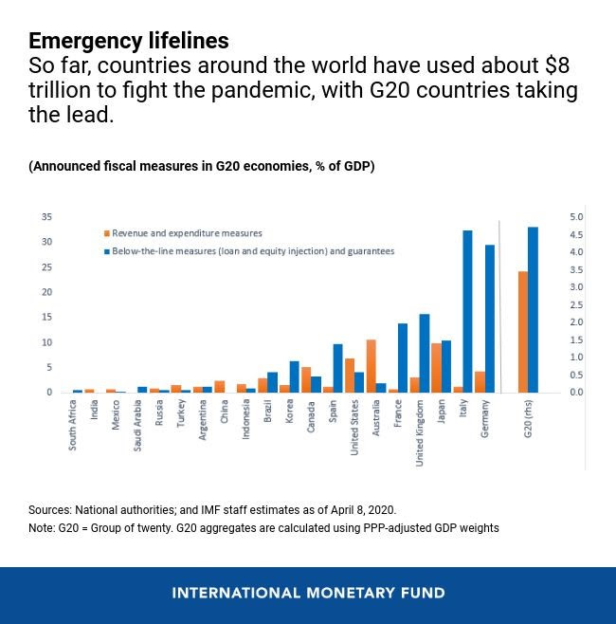

Slide 29
The struggle on 2 fronts…
And why they are linked
Consolidate state-led offensive against corruption – but widen to include capital flight, tax base erosion, abuse of tax havens
Defeat crippling austerity programme
  To build productive state capacity
  To address real issues facing working class and poor – triple crisis creating fertile ground for demagogic populism – xenophobia, JZ fight-back, EFF, bogus RET
  Public sector pay, BIG, UIF, NHI, public employment programmes
  Major social and economic infrastructure build
  MUST AVOID ANOTHER “STAGE-ISM
Without major stimulus – corruption won’t be defeated
Without corruption roll-back – stimulus will be consumed

